Slide 1
Microservices Implementation on Spring Cloud
Subramanian Murugan

Slide 2
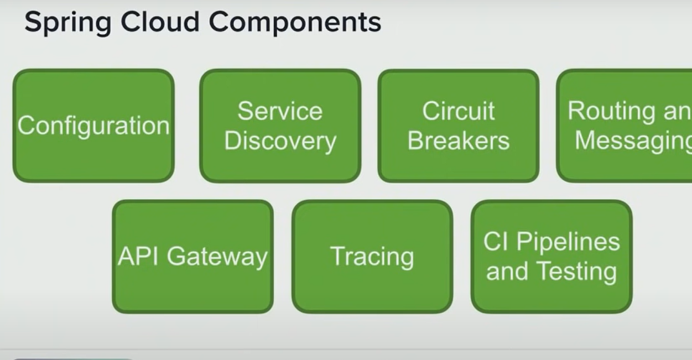

Slide 3
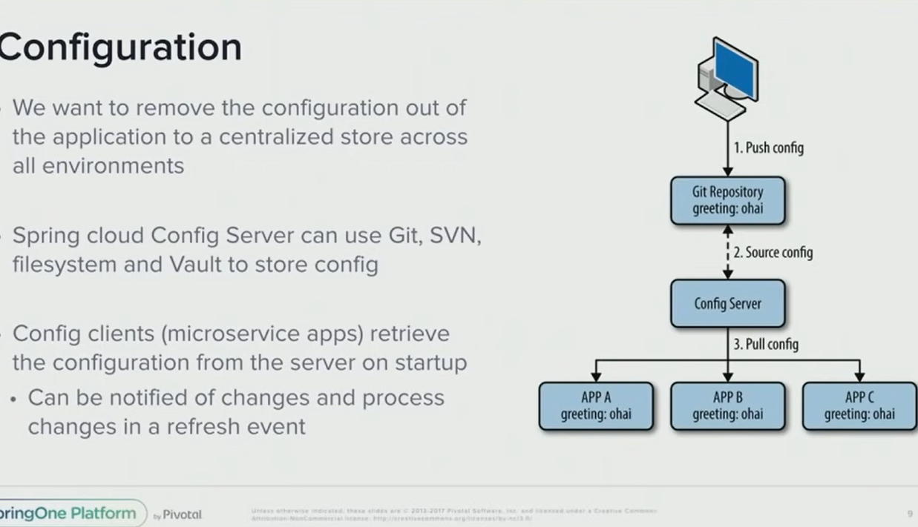

Slide 4
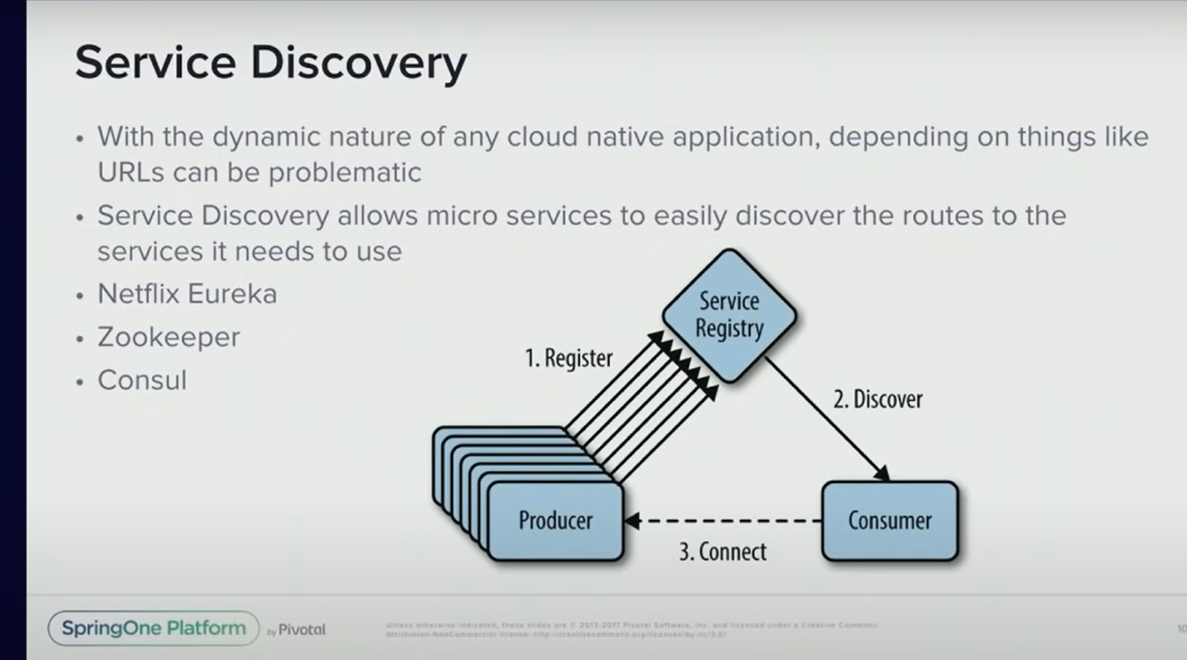

Slide 5
Microservice Pattern-Cross cutting concerns
Pattern: Externalized configuration

Slide 6
Context
An application typically uses one or more infrastructure and 3rd party services.
Infrastructure Services
Application Configuration Server
Service Registry Server
Database Server
Message Broker
3rd Party Services
Payment Processing
Email Services
Messaging Services

Slide 7
How to enable a service to run in multiple environments without modification?
A service must be provided with configuration data that tells it how to connect to the external/3rd party services. For example, the database network location and credentials
A service must run in multiple environments - dev, test, qa, staging, production - without modification and/or recompilation
Different environments have different instances of the external/3rd party services, e.g. QA database vs. production database, test credit card processing account vs. production credit card processing account

Slide 8
Solution
Externalize all application configuration including the database credentials and network location.
On startup, a service reads the configuration from an external source, e.g. OS environment variables, etc.

Slide 9
Implementation- Spring Boot externalized configuration
Externalize all application configuration including the database credentials and network location.
On startup, a service reads the configuration from an external source, e.g. OS environment variables, etc.

Slide 10
Types of Configuration
Push model—The deployment infrastructure passes the configuration properties to the service instance using, for example, operating system environment variables or a configuration file.
Pull model—The service instance reads its configuration properties from a configuration server.

Slide 11
PUSH Based Model

Slide 12
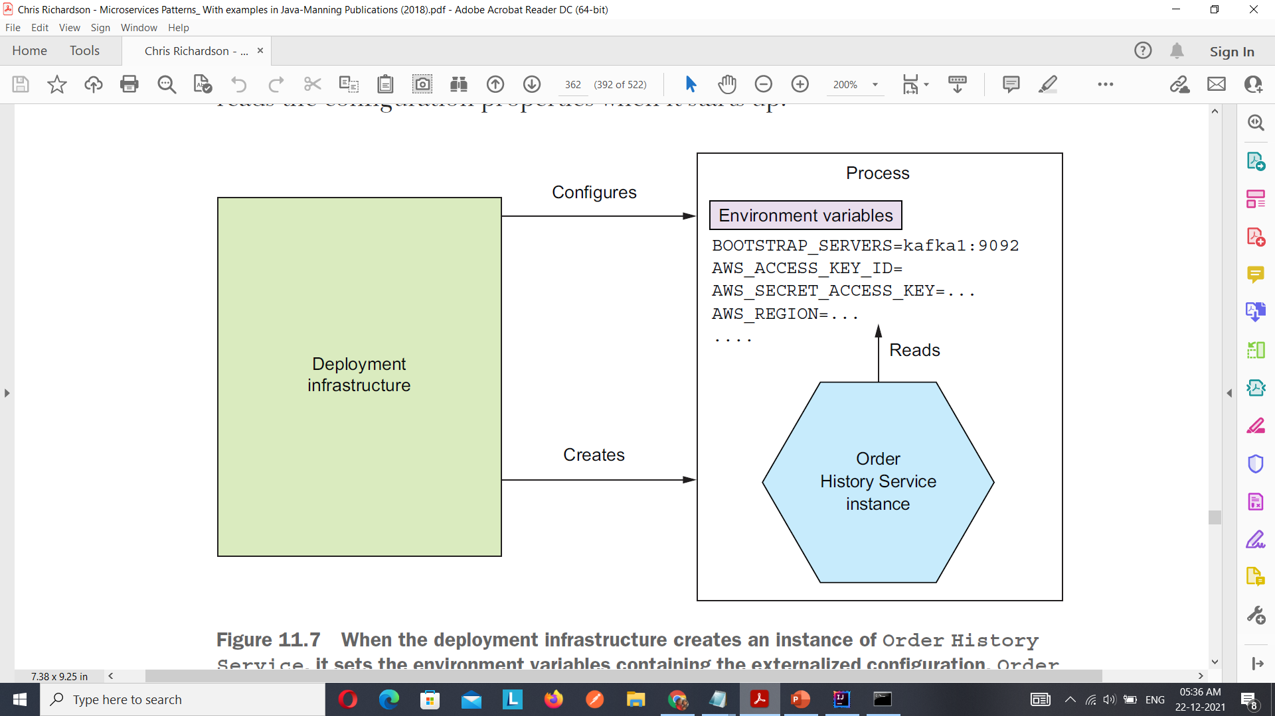
When the deployment infrastructure creates an instance of Order History Service, it sets the environment variables containing the externalized configuration. Order History Service reads those environment variables.

Slide 13
Demo
How to read Properties from application.properties/yml
How to read properties from command line

Slide 14
Pull Model
In the pull model, a service instance reads its configuration properties from a configuration server.
On startup, a service instance queries the configuration service for its configuration

Slide 15
Pull based Model implementation
Version control system such as Git
SQL and NoSQL databases
Specialized configuration servers, such as Spring Cloud Config Server, Hashicorp Vault, which is a store for sensitive data such as credentials, and AWS Parameter Store

Slide 16
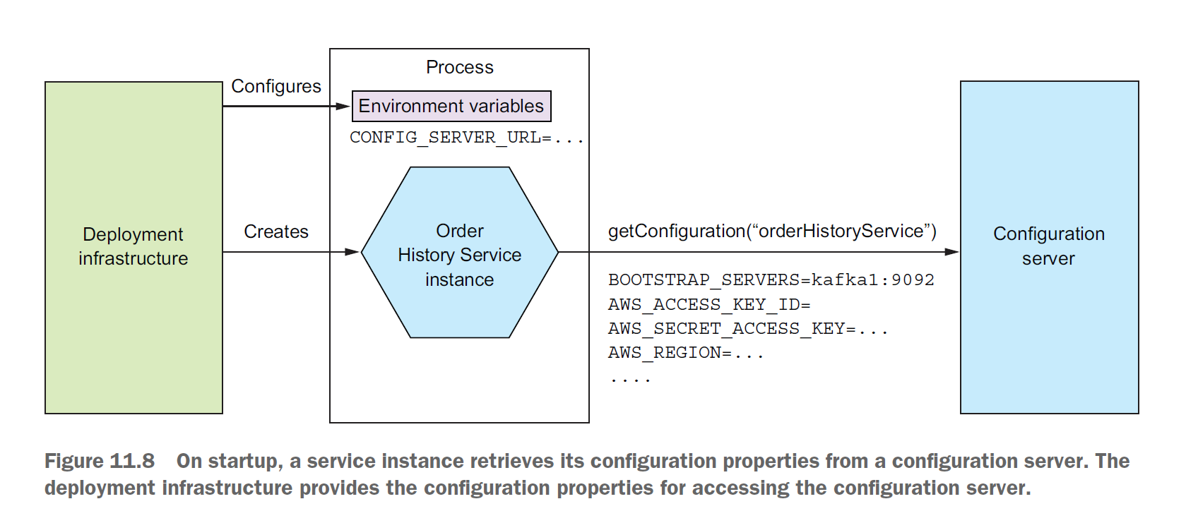
Pull based Model implementation

Slide 17
Spring Cloud Config
The Spring Cloud Config project is a good example of a configuration server-based framework. It consists of a server and a client.
The server supports a variety of backends for storing configuration properties, including version control systems, databases, and Hashicorp Vault.
With the Config Server, you have a central place to manage external properties for applications across all environments.
The client retrieves configuration properties from the server and injects them into the Spring ApplicationContext

Slide 18
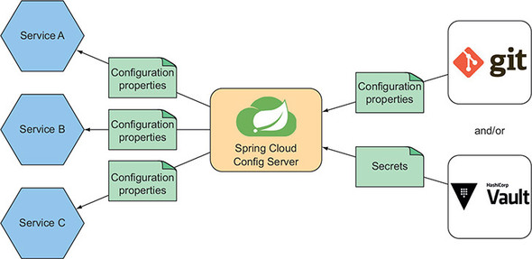
Spring Cloud Config Server

Slide 19
Demo

